Slide 1

Image Captioning using Attention Models
Rajesh Shreedhar Bhat & Souradip Chakraborty

Slide 2
Session Agenda
Intro to Image Captioning
Real life use cases of image captioning.
History & Evolution of Image Captioning
Sequence to Sequence Learning in NLP
Show and Tell : Sequence to Sequence Learning in Vision
Intuition of Attention Mechanism from Translation perspective
Show Attend and Tell : Image Captioning with Attention
Beam search in generative framework
Code walk-through in PyTorch

Slide 3
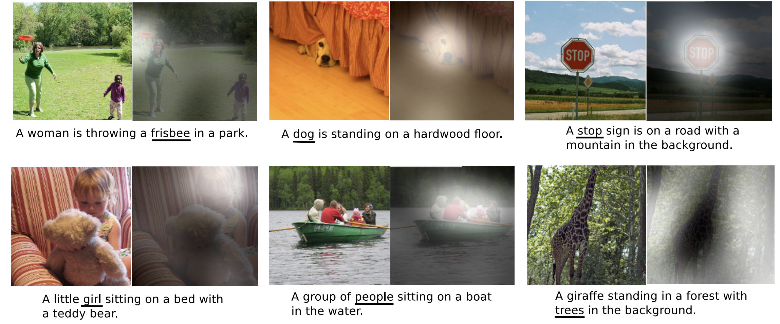
Introduction to Image Captioning
Image captioning is the task of generating a descriptive and appropriate sentence of a given image.
Caption generation is a challenging AI problem where a textual description must be generated for a given image.
Two tasks involved:
Understand the content of the image.
Turn the understanding of the image into words in proper order.
Notes:
Requires both methods from computer vision to understand the content of the image and a language model from the field of natural language processing to turn the understanding of the image into words in the right order.

Slide 4
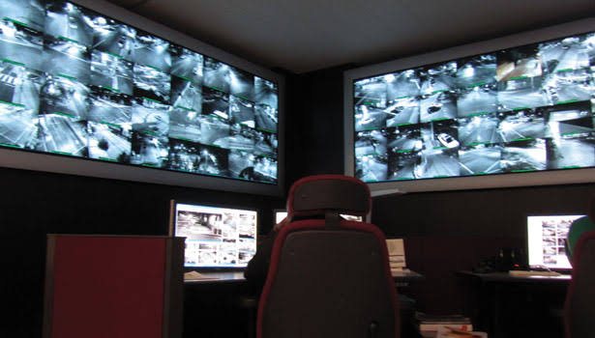
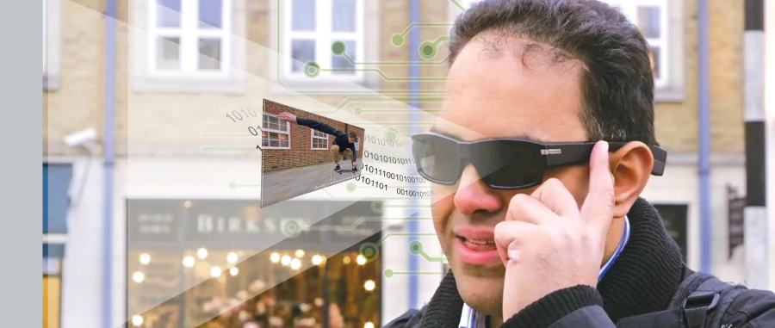
Real Life Use Cases of Image Captioning
Search using image captions.
Getting live captions from CCTV/Surveillance cameras.
Aid to visually impaired people.
Notes:
https://news.microsoft.com/en-my/2017/12/20/virtual-sight-app-developer-helping-visually-impaired-see/
https://www.securitymagazine.com/articles/83540-how-to-hire-the-right-security-integrator

Slide 5
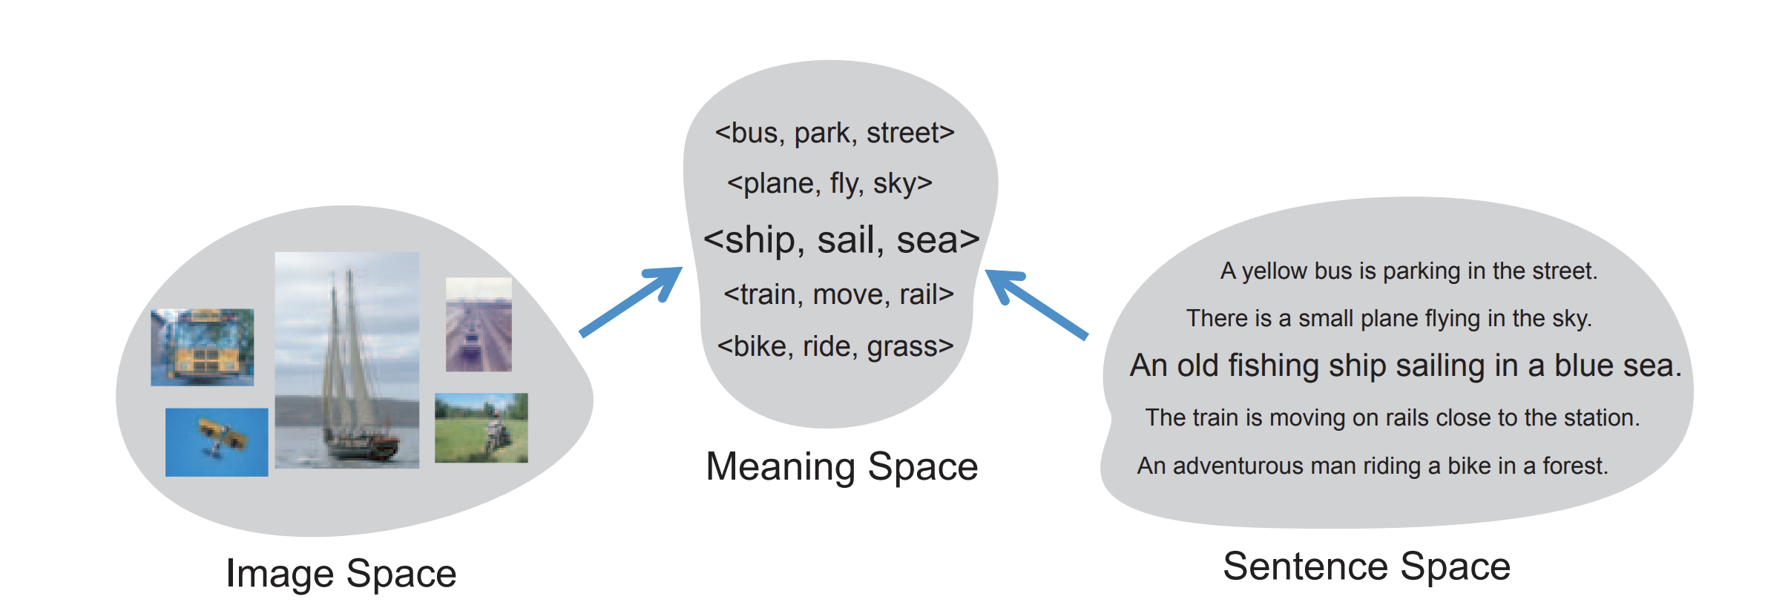
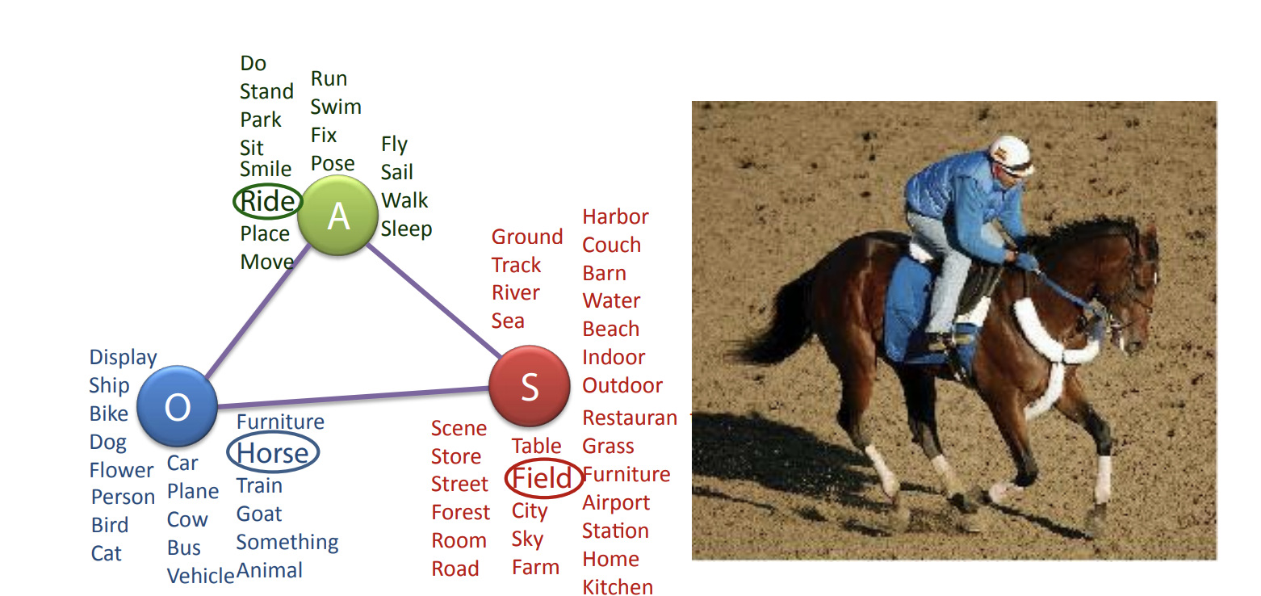
Every Picture Tells a Story: Generating Sentences from Images
Defining Pre-defined Template of Object- Action-Scene
Mapping Image and Sentence to Latent Meaning Space
Multi-label Markov Random Field to predict triplet from image
https://www.cs.cmu.edu/~afarhadi/papers/sentence.pdf

Slide 6
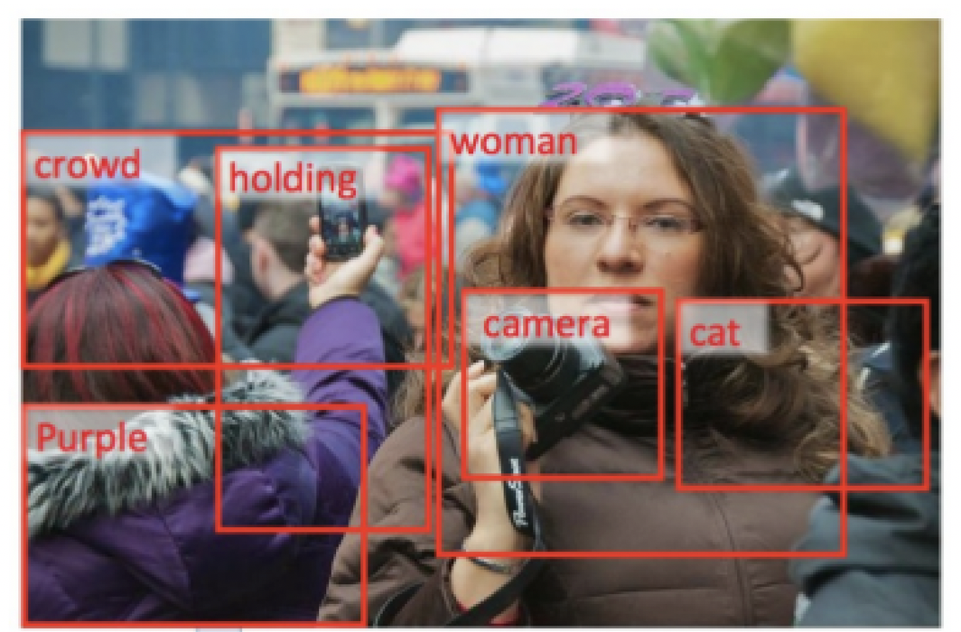
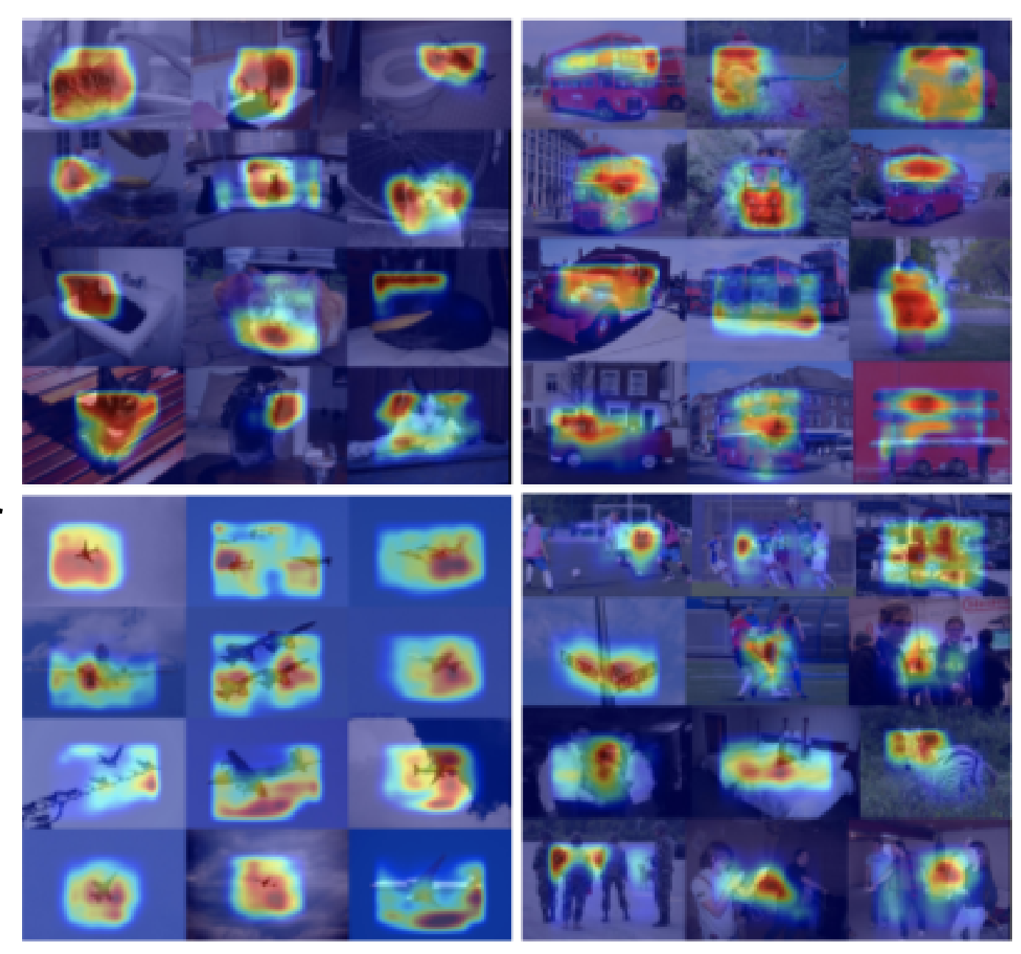
From Captions to Visual Concepts and Back
Word Detection Stage & Multiple Instance Learning
Word Detection Stage
Sentence Generation Stage
Ranking Generated Sentences
https://www.cv-foundation.org/openaccess/content_cvpr_2015/papers/Fang_From_Captions_to_2015_CVPR_paper.pdf

Slide 7
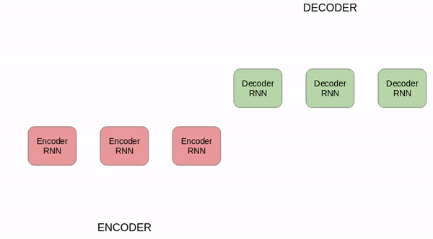
Sequence-to-Sequence models
The encoder-decoder architecture has received a lot of popularity in solving sequence to sequence problems in NLP domain.
Example – Language Translation, Chatbots, Text summarization, etc.
Encoders & Decoders in sequence-to-sequence learning
Encoder: processes each word in the input sequence and compiled information is put into context vector C.
Context vector C is passed to the decoder.
The decoder also maintains a hidden states that it passes from one time step to the next.

Slide 8
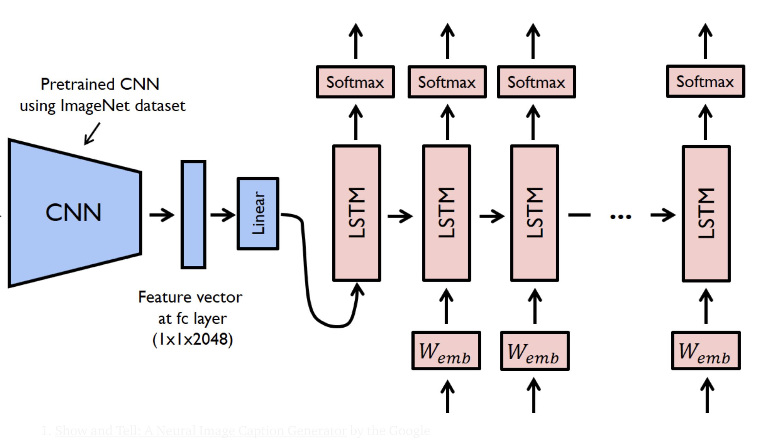
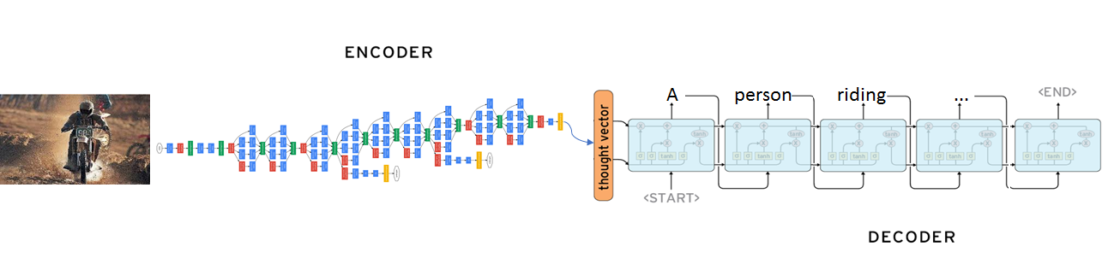
Show and Tell: A Neural Image Caption Generator
CNNs can very efficiently encode the abstraction of images and generate a robust representation.
Robust representation acts as the context/thought vector to the decoder.
The decoder is a standard LSTM/GRU units same as that in sequence to sequence architectures.
“Show and Tell: A Neural Image Caption Generator”: https://arxiv.org/pdf/1411.4555.pdf
Notes:
Only the last hidden state of the encoder RNN is used as the context vector for the decoder
Attention was introduced to address the problem of long sequences

Slide 9
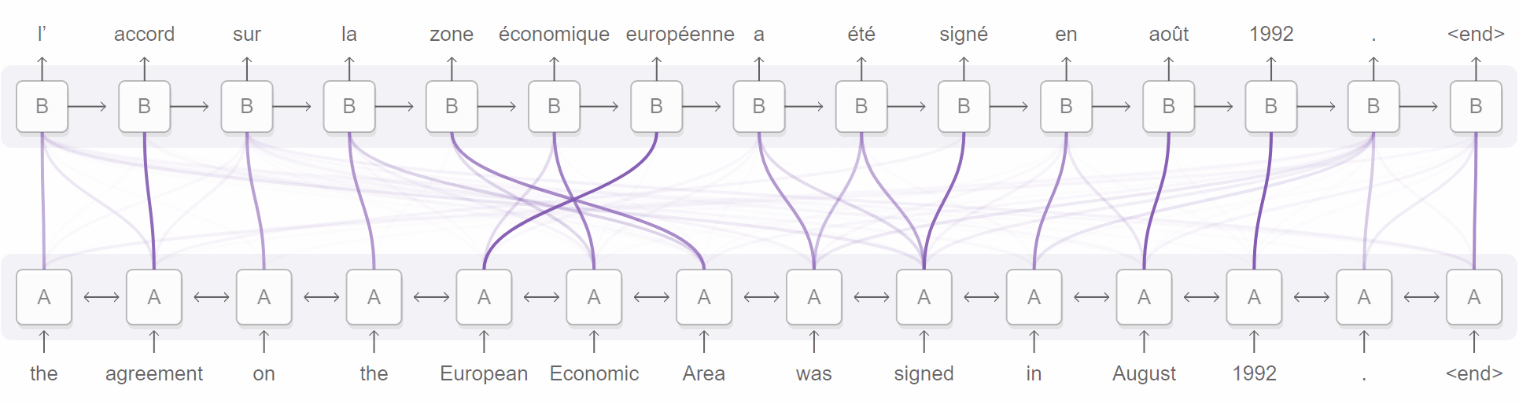
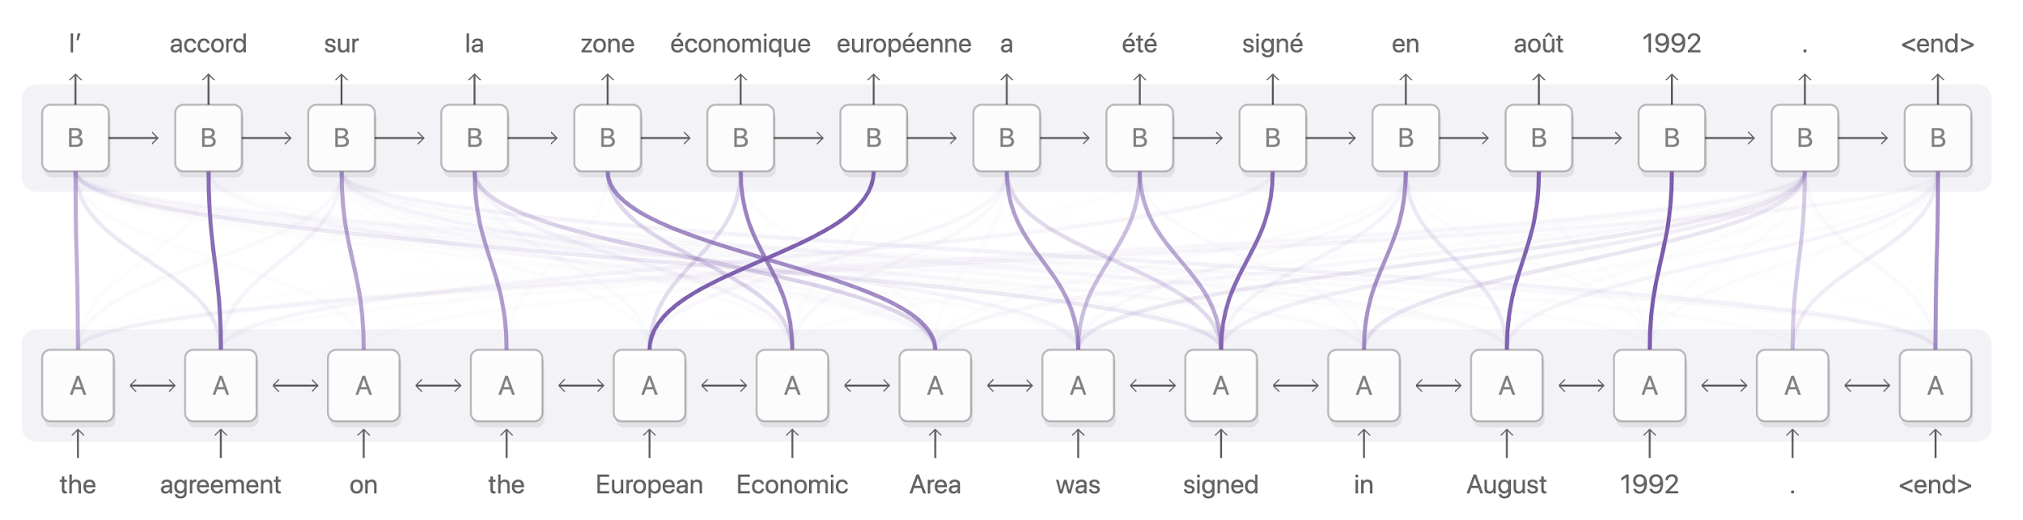
Attention Mechanism Intuition
Source: https://distill.pub/2016/augmented-rnns/

Slide 10
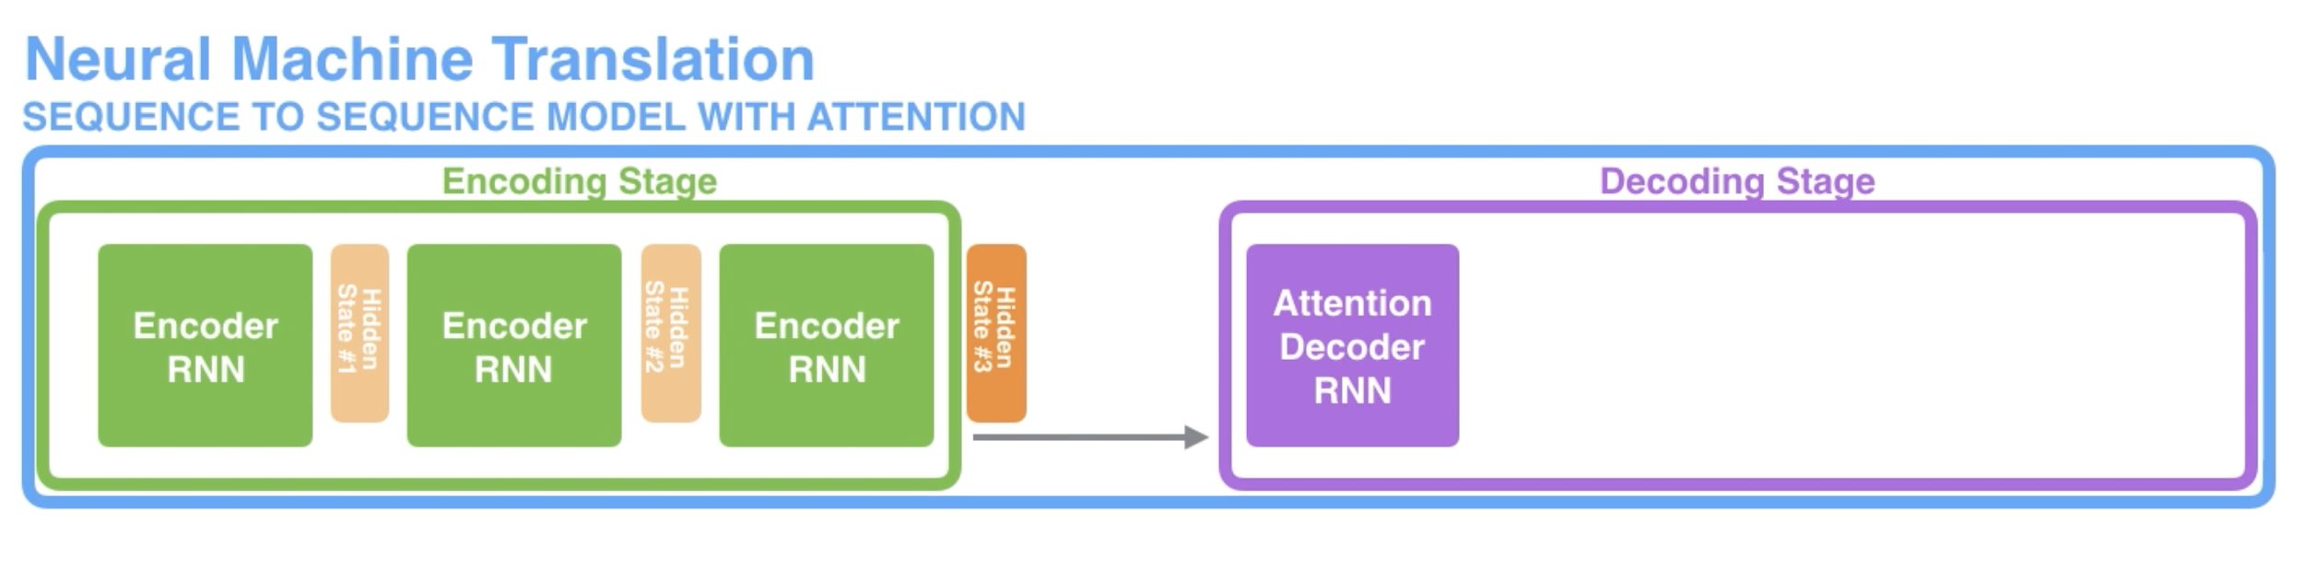
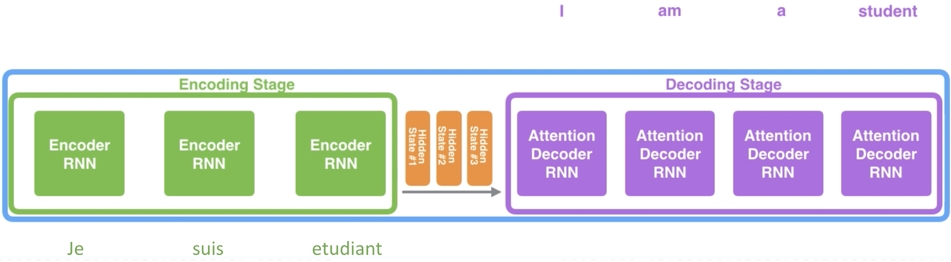
Sequence to Sequence Model with Attention

Slide 11
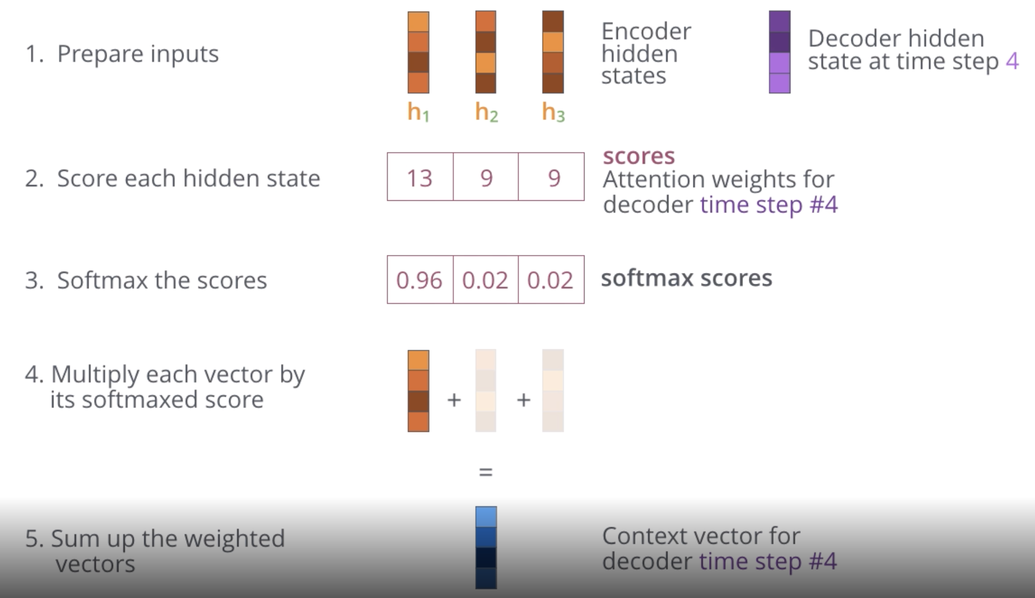
Obtaining Context Vector using Attention
Source: http://jalammar.github.io/visualizing-neural-machine-translation-mechanics-of-seq2seq-models-with-attention/

Slide 12
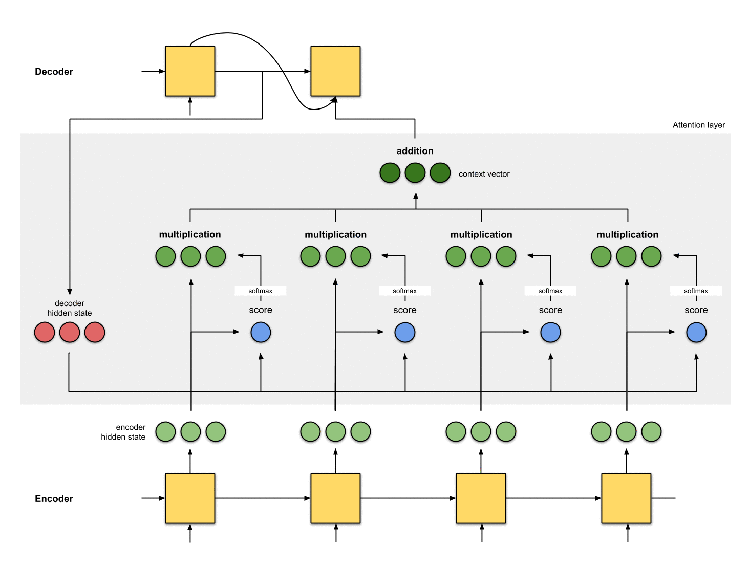
Attention is all you need: Brief Overview

Slide 13
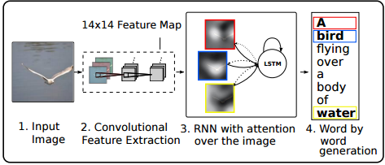
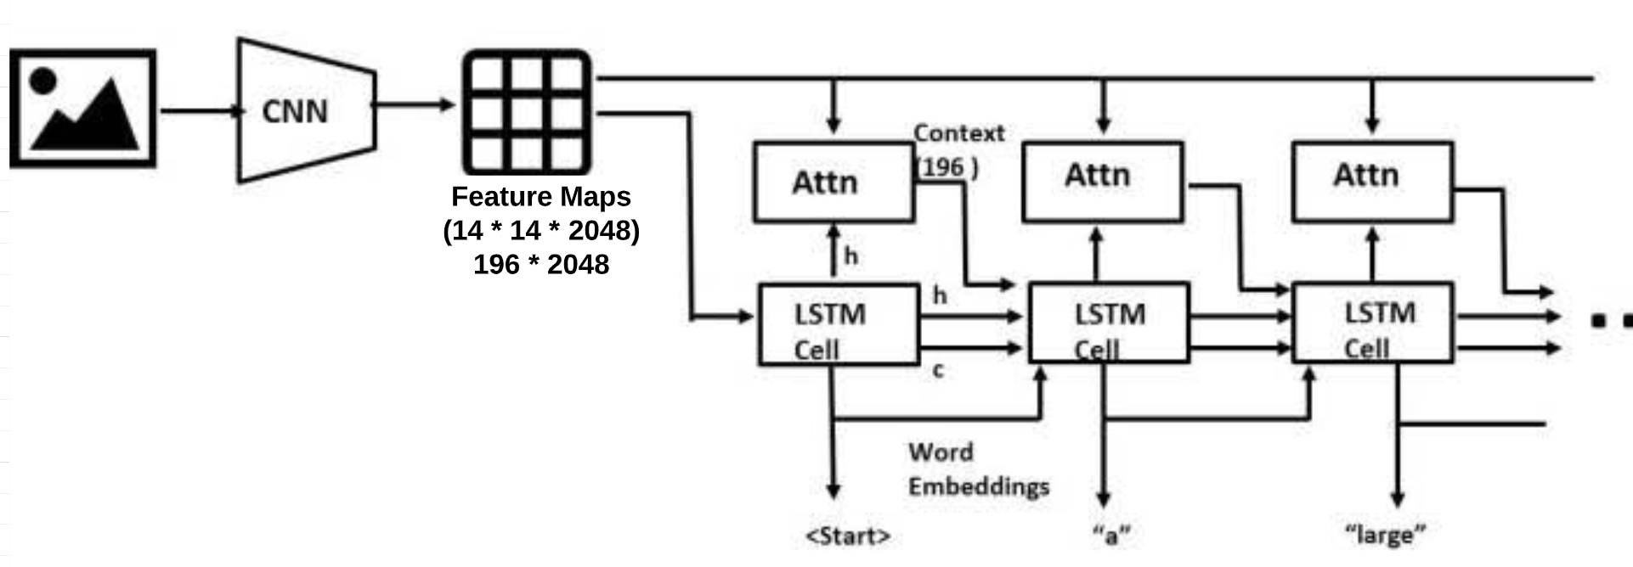
Show Attend and Tell: A Neural Image Caption Generator
Inspired by the usage of Attention mechanism in Language Translation task.
Focus on salient parts of the image while generating the corresponding word in the output sentence.
“Show Attend and Tell: A Neural Image Caption Generator”: https://arxiv.org/pdf/1502.03044.pdf
Notes:
As you generate a caption word by word, you can see the model's gaze shifting across the image.

Slide 14
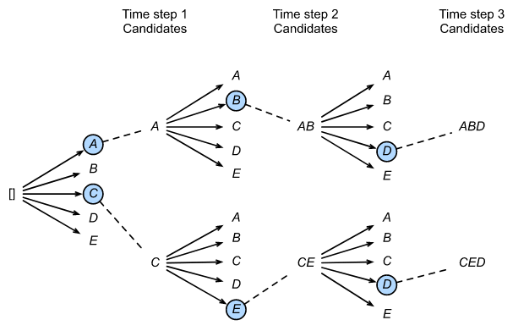
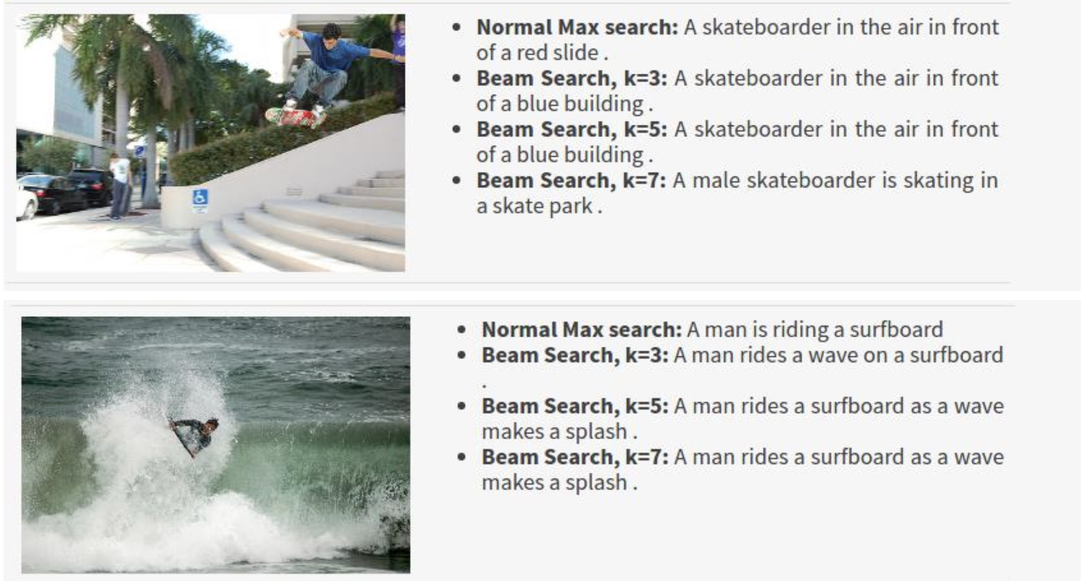
Caption Generation using Beam Search
The greedy approach to choose the word with the highest score and use it to predict the next word is not optimal.
Reason: the rest of the sequence hinges on that first word you choose.
Beam Search is useful for any language modeling problem because it finds the most optimal sequence.
Beam Size = 2

Slide 15

Code walkthrough - PyTorch
https://github.com/rajesh-bhat/dhs_summit_2019_image_captioning

Slide 16

Thank you!

